Slide 1
Orchard Stewardship Incentive Program
Cool Farm Tool Assessment:
Triple Diamond Level
Kabir Tumber, Membership Development Manager

Slide 2
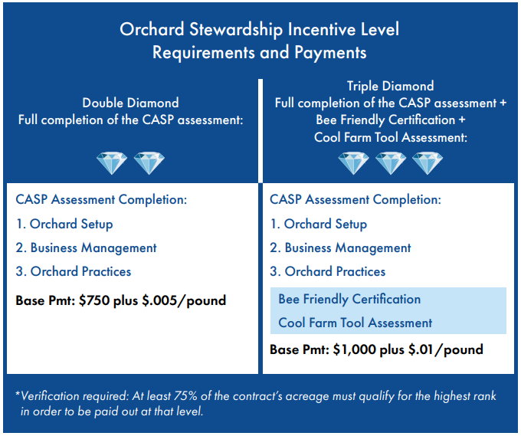
Requirements by Level

Slide 3
Table of Contents
Slides 4 – 18 For New Users
Slides 19 – 24 For Returning Users

Slide 4
www.coolfarmtool.org

Slide 5
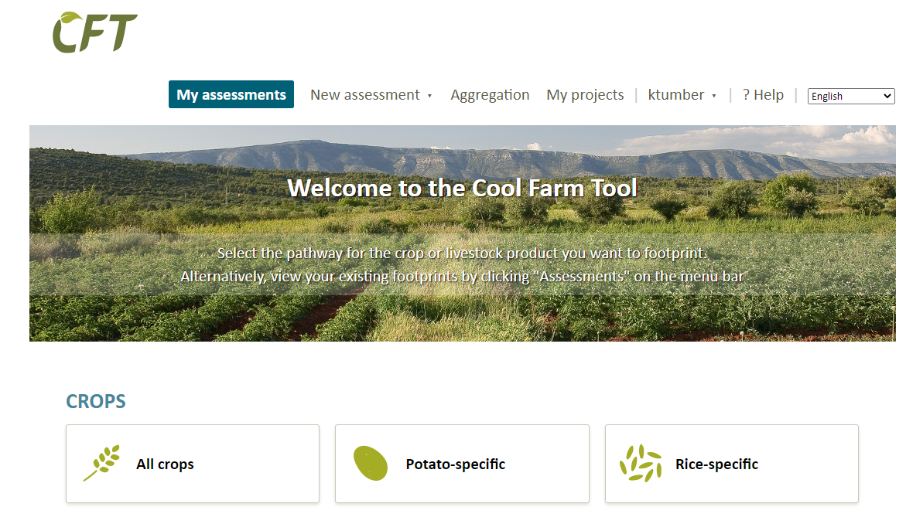
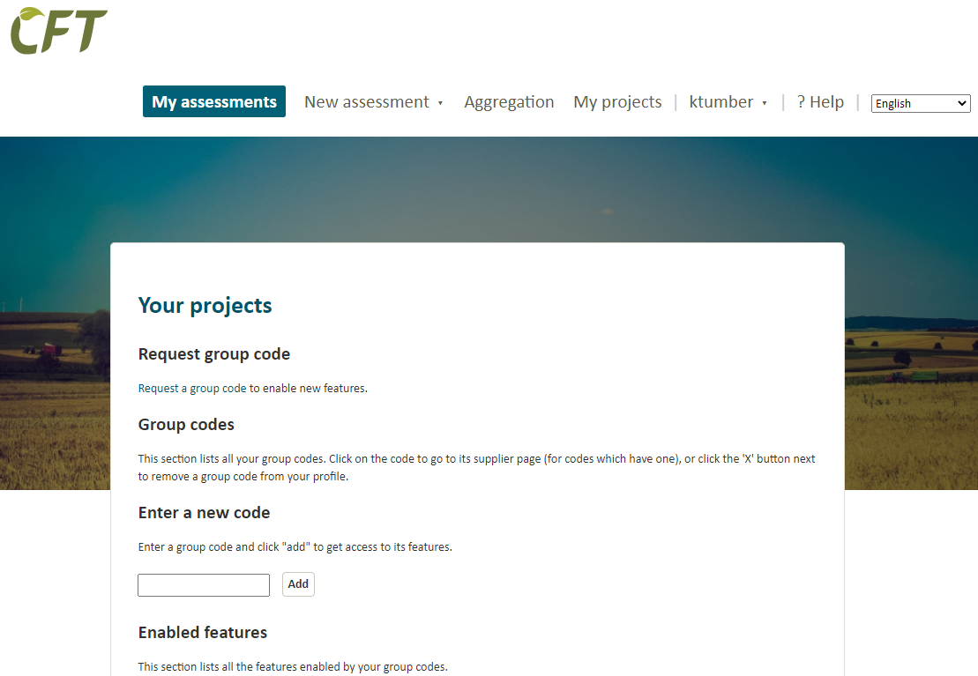
Enter “BDGOSIP” and Click “Add”

Slide 6
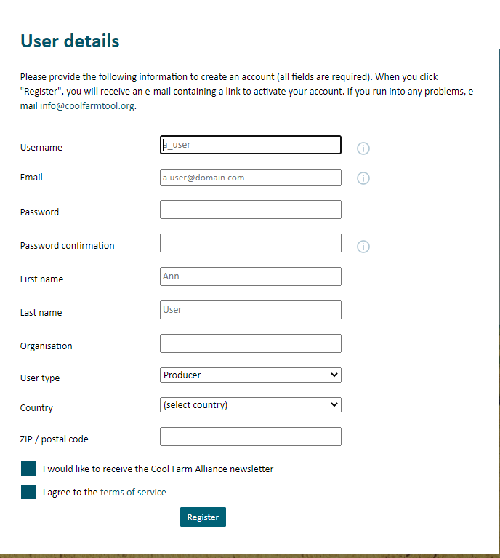
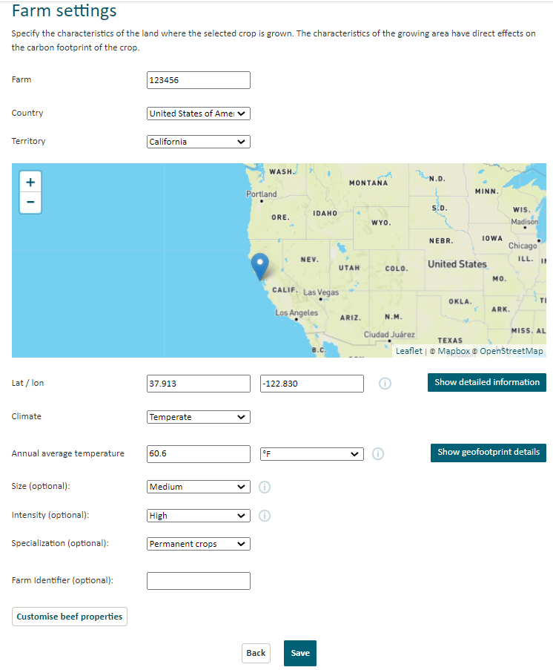
Enter your Blue Diamond Contract #

Slide 7
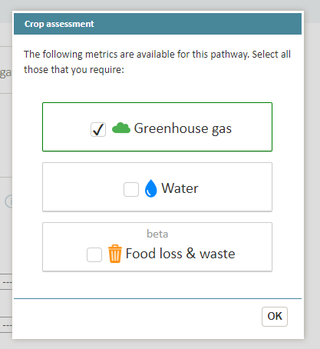
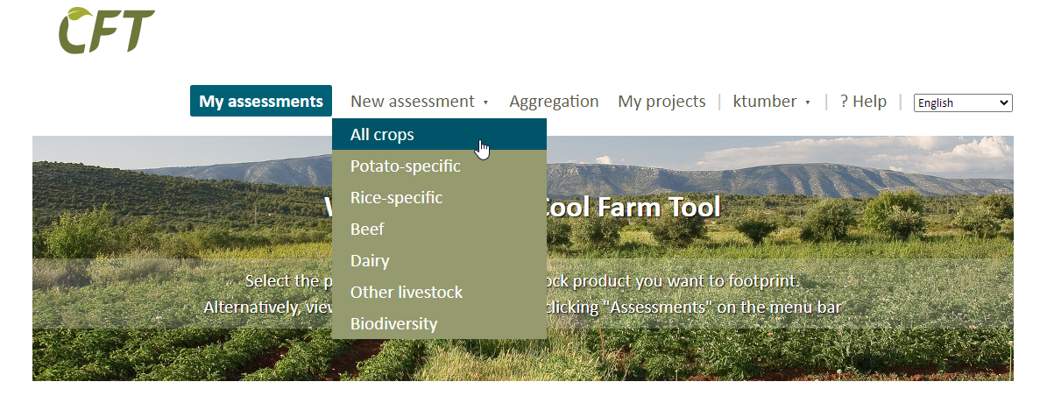

Slide 8
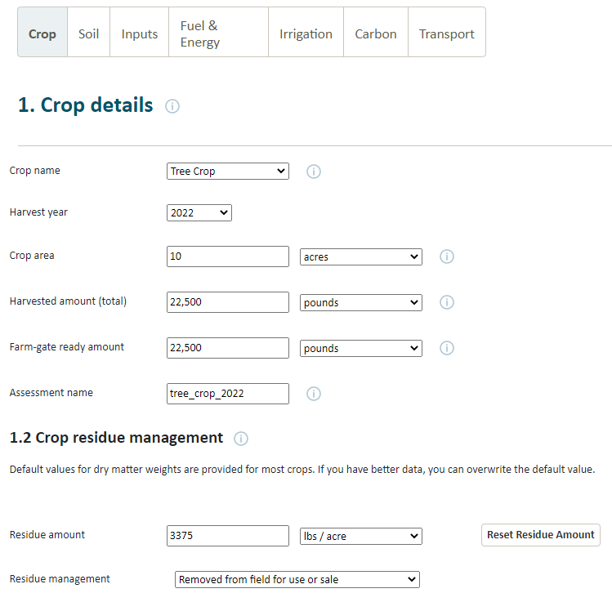
10 Acres @ 2250 lbs/ acre = 22,500 / acre kernel wt.
Multiply x 2.5 = 56,250 = 56,250 lbs. gross
with shell and hull
Gross 56,250 – Kernel 22500 = 33,750 (residue amount)
33,750/10= 3,375 Residue (Hull &Shell)
Almonds Produce Three Crops
Kernel, Shell & Hull – Account for all
Typically Kernels = 30-40% of total weight
Or
1:2.5 to 1:3 Kernel to Hull/shell

Slide 9
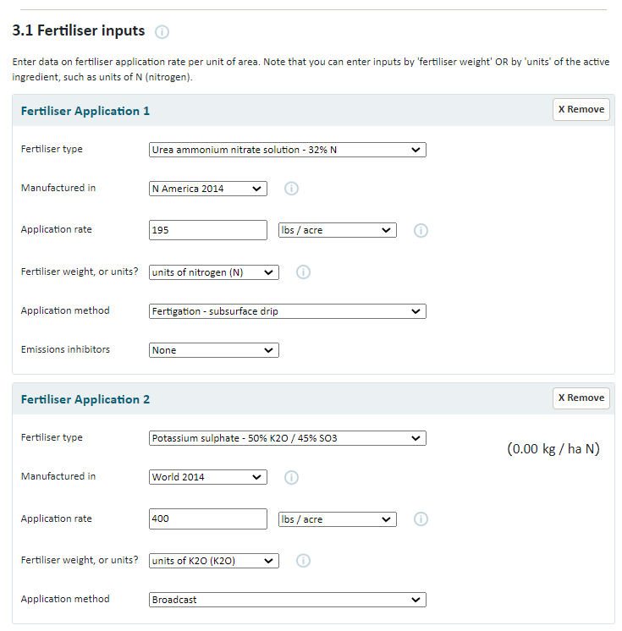
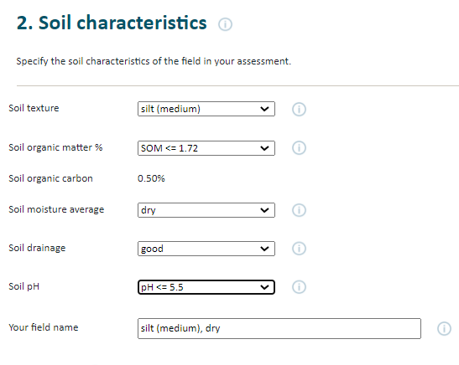

Slide 10
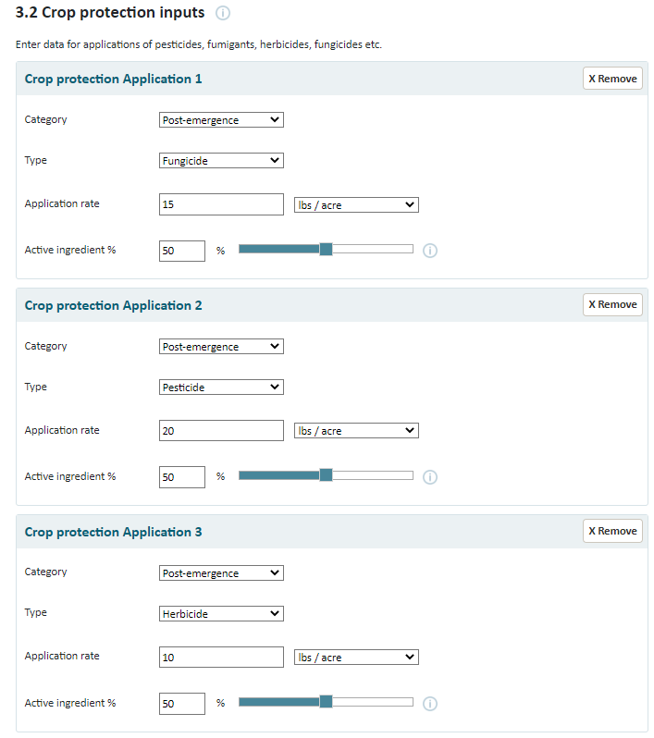
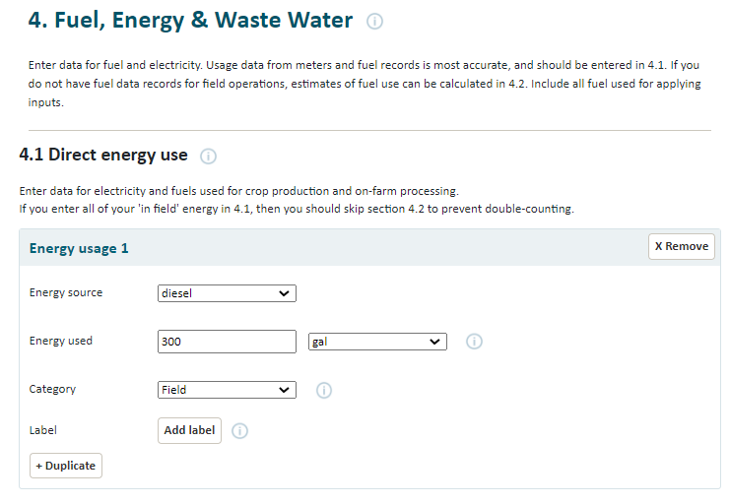
Input all crop protection activities one by one in the “Crop protection inputs” section

Slide 11
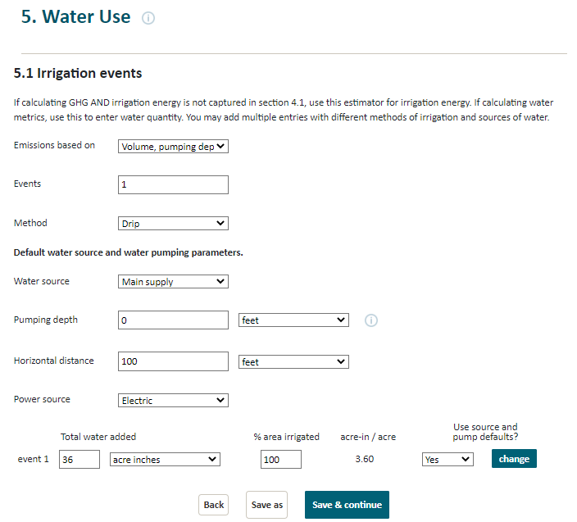
Note: output results are not impacted by changing the number of irrigation events, if applied water rates remain the same in total (e.g. 20 events at 2 acre-inches (40 total acre-inches) is the same as 4 events at 10 acre-inches (40 total acre-inches))

Slide 12
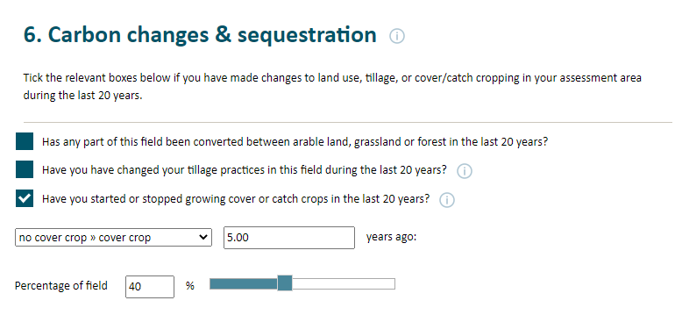
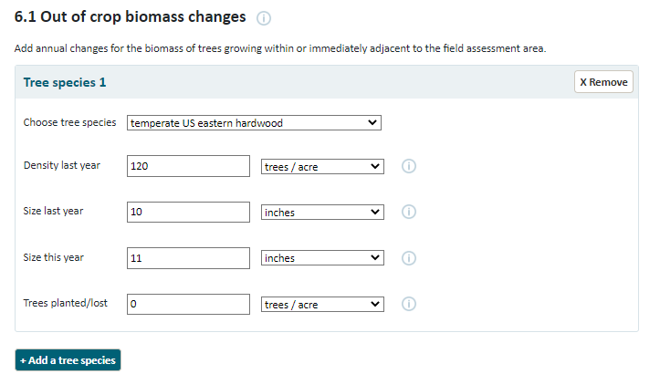

Slide 13
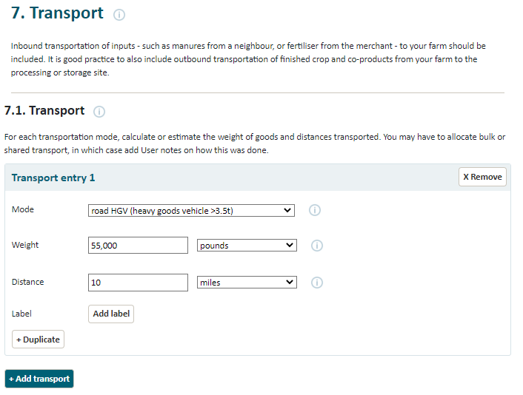
Include transportation from orchard to huller / huller-sheller

Slide 14
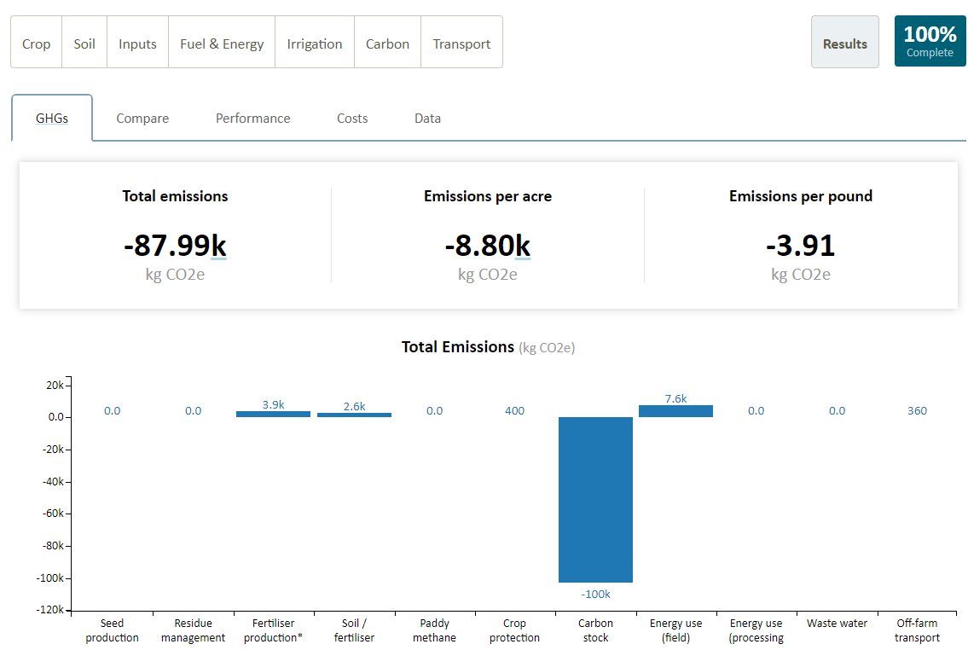

Slide 15
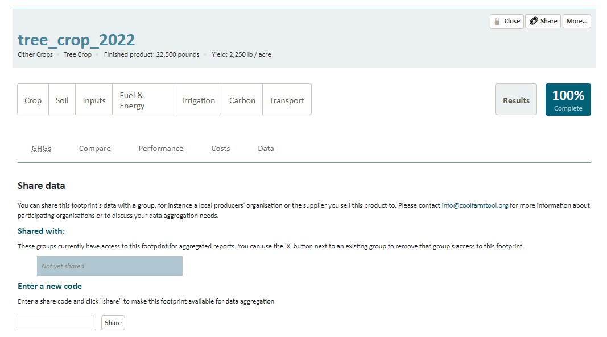
Upon completing the assessment, you will need to anonymously share the results to Blue Diamond
Upon completion, click the “Share” button on the top right corner of the screen
Enter “BDGOSIP” and Click “Share”

Slide 16
Upon completing the assessment, you will also need to upload your results to the online application
Upon completion, click the “More” button on the top right corner of the screen

Slide 17
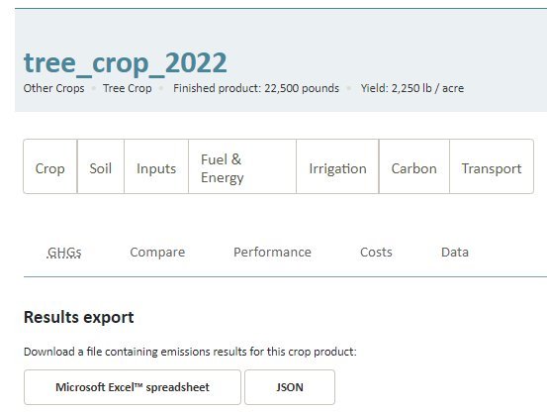
Export the results into Microsoft Excel
Note that the results only show the assessment results, not the input values
Upload the exported Excel file to the online application form

Slide 18
Cool Farm Tool (www.coolfarmtool.org)
Parameters:
Type = Tree Crop
Climate = Temperate
Avg Temperature = 60.6 F
Specialization =Permanent Crop
Note: Be sure to list Almond Shell & Hull as “Co-Product” typically 1 lb kernel to 2.5 lb hull/shell
Be Sure to add “Out of Crop Biomass Changes” (section 6.1)

Slide 19
For Returning Users
Enter “BDGOSIP” and Click “Add”

Slide 20
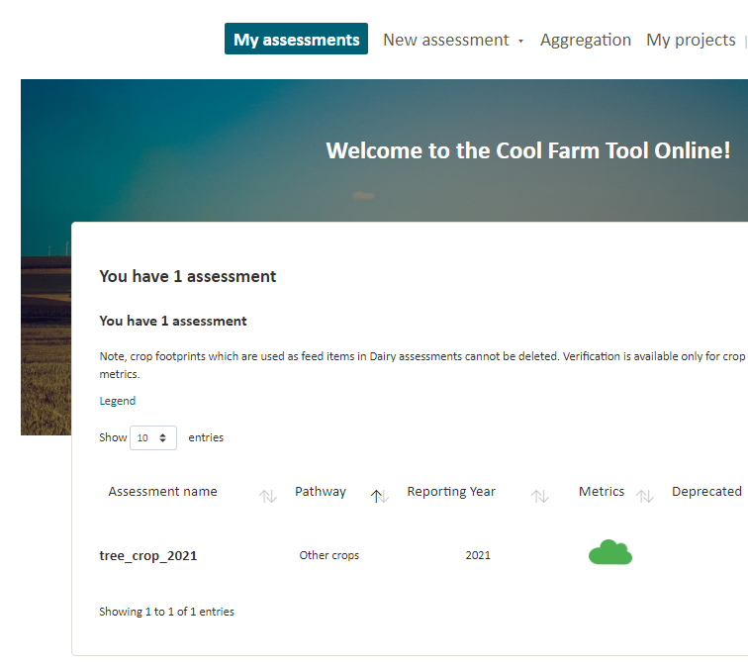
Click on last year’s assessment

Slide 21
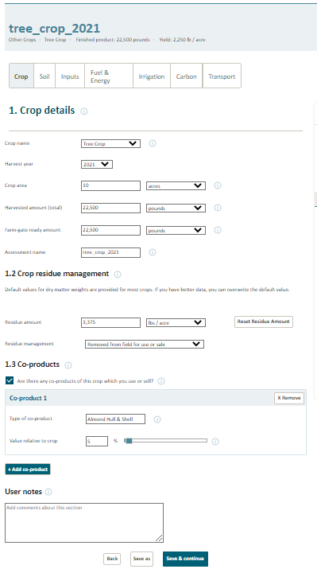
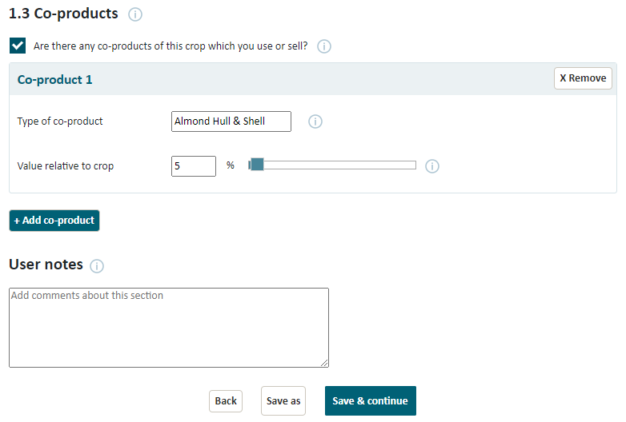
Scroll to the bottom of last year’s assessment and click “Save As”

Slide 22
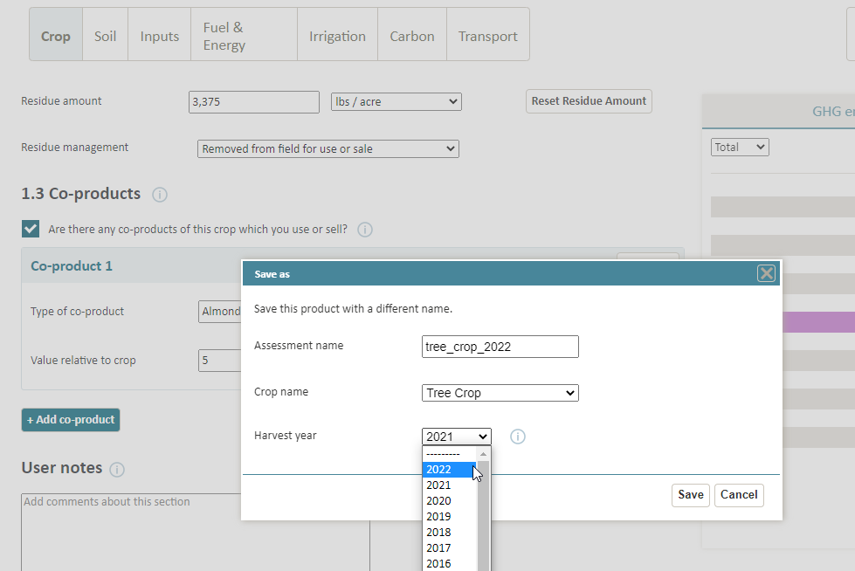
Change the Assessment name to include 2022 and change the Harvest year in the drop-down options and click “Save”
Once saved, enter the 2022 assessment and update the information to reflect your 2022 season

Slide 23
Upon completing the assessment, you will need to anonymously share the results to Blue Diamond
Upon completion, click the “Share” button on the top right corner of the screen
Enter “BDGOSIP” and Click “Share”

Slide 24
Upon completing the assessment, you will also need to upload your results to the online application
Upon completion, click the “More” button on the top right corner of the screen

Slide 25
Export the results into Microsoft Excel
Note that the results only show the assessment results, not the input values
Upload the exported Excel file to the online application form

